Slide 1


SAP HYBRID/OFFLINE
FIORI TRAINING
SAP MDK TRAINING
www.anubhavtrainings.com

Slide 2


Agenda
Who is this course for ?
Course outlook
What we see today
Live Demo
FAQs

Slide 3





WHO IS THIS COURSE FOR
www.anubhavtrainings.com
UX Designer – Andrew Shaw
Technical Advocate – Larry
Fresher – Johns Peter
Jeon Brown – Application Developer
A UX Designer, she would like to start development of UI5 applications
Working in industry with other UI technology and want to be a UI developer with SAPUI5
Fresher with no experience, and aspire to become a full stack developer
Working as an ABAP consultant, want to build apps on ECC or S/4HANA

Slide 4




COURSE OUTLOOK
Setup Tools
01
Setup the required development tools VS Code, Java, Node JS, Cordova, Plug-ins, Gradle etc..
STEP
www.anubhavtrainings.com
Develop Hybrid App
02
Understand Cordova plugin, package and build android and iOS applications
STEP
Plugins and offline feature
03
Build offline mobile applications, integrate barcode, integrate camera
STEP
SAP MDK with Business App Studio
04
SAP Mobile Development Kit with business application studio
STEP

Slide 5

What we see today?
Develop First mobile app
Develop a simple mobile app and run-on Android device.

Slide 6


Requirement
Rohan – SAP UI5 developer
Rohan is a UI5 consultant, he created many UI5 applications in the past. He is a trained professional by Anubhav Trainings on Fiori development. He would like to create a mobile application out of his existing Fiori app.
www.anubhavtrainings.com

Slide 7










Title
Content
www.anubhavtrainings.com

Slide 8
Need?
We are already working on SAP UI5 technology and building Fiori apps in our company. How can we use these applications in the mobile phone.
Ask user to open a browser and enter the url of sap Fiori launchpad. User mobile phone should be connected to company network.
SAP provide an app called Fiori client, deletion of this app from store.
No Native experience
Client wants to publish their own apk
Own branding on app logo
No device capability
Fiori App
M
Fiori App
FLP
Fiori App
S/4HANA
T
www.anubhavtrainings.com

Slide 9
Approaches to develop a mobile?
There are various ways to build a mobile app in the mobile application development landscape such as Native iOS, Native android, Cordova, App-accelerator Titanium and more..
Native App Development
Cross Platform
Hybrid Approach
Need to learn the skills according to the platform.
iOS – Objective C/ Swift
Android – java
Windows – C#
They interact directly with platform. Speed of the app is very fast
Get the native OS support.
Effort and cost is very high
Develop separate code for each platform
Maintain different code repositories
Testing effort
Built using intermediate languages powered by JS
Build more closer native experience
React, Angular
Convert to the android, ios
Some frameworks are only specific to android
Only targeting mobile, run app for desktop and auto adapt
Cost is higher
The runtime is HTML5, like SAP UI5. Supported by browser
Frameworks like cordova, which works like a container. They have an embedded browser which transparent from user.
Cordova, iconic, Telerik
Low cost and effort
Same experience work in mobile
Cross platform
There is a noticeable difference
Controls support
Speed
Able to use some specific device feature
www.anubhavtrainings.com

Slide 10
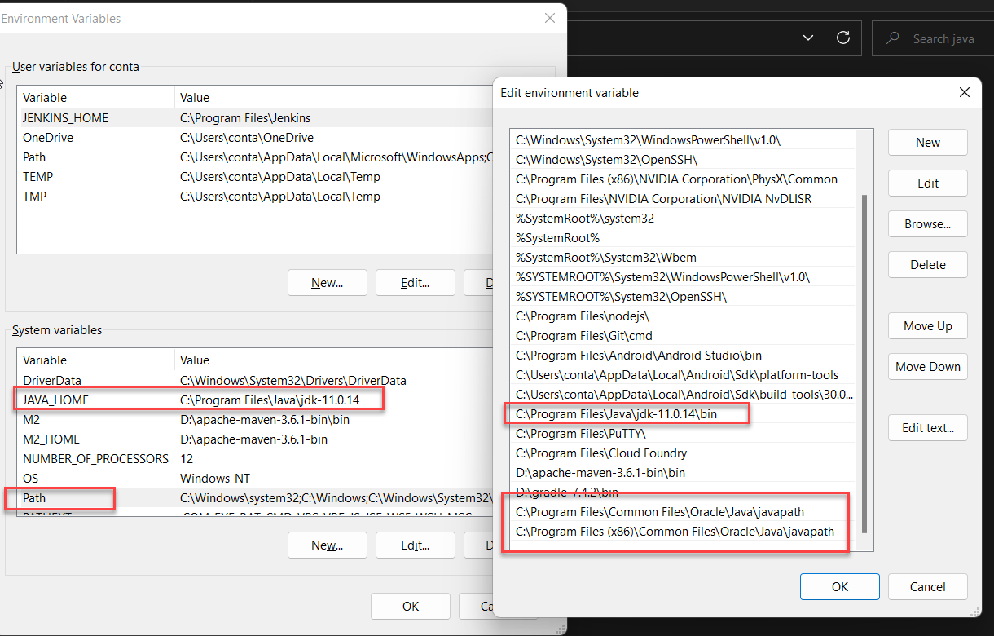
What is Cordova
Apache cordova is an open-source mobile development framework which allows us to leverage standard web technologies such as HTML5, CSS, JS, JQ for building a cross platform application (android, windows, ios)
With apache cordova framework we build native-like app targeting mobile users of our app with device capability. This framework is industry best practice, easy to learn and free.
https://cordova.apache.org/docs/en/latest/guide/overview/
Tools and pre-requisite
Java Installation ➔ Java 11 is the recommended installation. JDK = JRE (Java Runtime Environment + Tools), You can use java -version command to check if java is already installed. https://www.oracle.com/in/java/technologies/javase/jdk11-archive-downloads.html
We can check the java directory c:\Program Files\java
www.anubhavtrainings.com

Slide 11
Setup for building app
2. Install the node JS – a Java script framework which provide runtime environment to execute JS code outside browser. Its free and open source. This will be required to install cordova and its plugin.
To check if node already there, use command node -v
https://nodejs.org/en/blog/release/v16.16.0/
Windows 64-bit Installer: https://nodejs.org/dist/v16.16.0/node-v16.16.0-x64.msi
We need to install cordova, and sap ui5 tooling in our machine
npm install -g @ui5/cli
npm install -g @sap/ux-ui5-tooling
npm install -g cordova
npm install -g yo
Ready or not
ui5 --help
fiori --help
cordova --help
yo --help
https://npmjs.com
www.anubhavtrainings.com

Slide 12
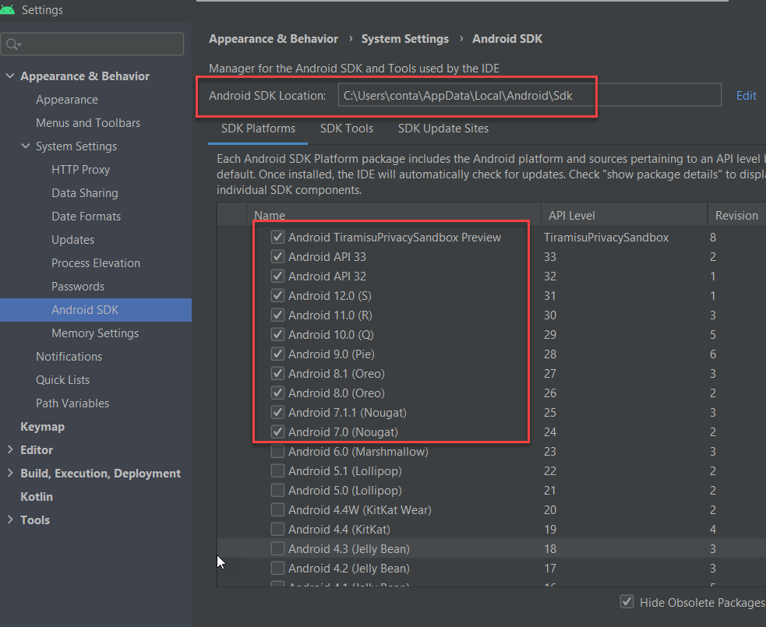
Android Studio and VS Code
Android Studio
Provides SDK manager and Simulators (AVD Manager). Almost 2 GB.
https://developer.android.com/studio
https://developer.android.com/studio/releases/build-tools
ANDROID_HOME | C:\Users\yourown\AppData\Local\Android\Sdk
ANDROID_SDK_ROOT | C:\Users\yourown\AppData\Local\Android\Sdk
Path | C:\Program Files\Android\Android Studio\bin
Path | C:\Users\conta\AppData\Local\Android\Sdk\platform-tools
Path | C:\Users\conta\AppData\Local\Android\Sdk\build-tools\30.0.2
www.anubhavtrainings.com

Slide 13
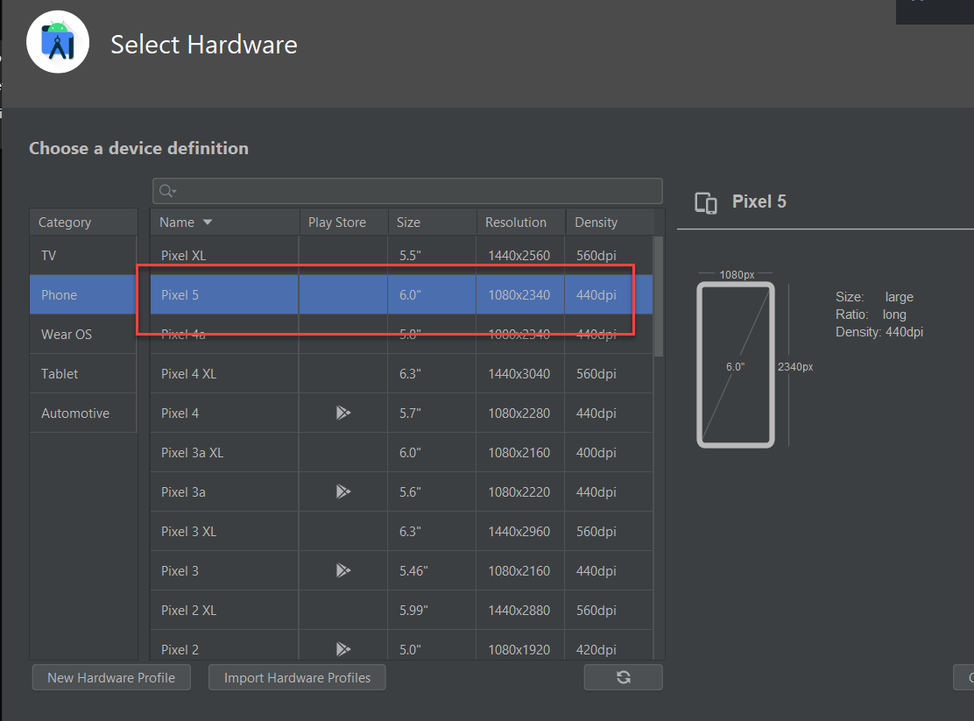
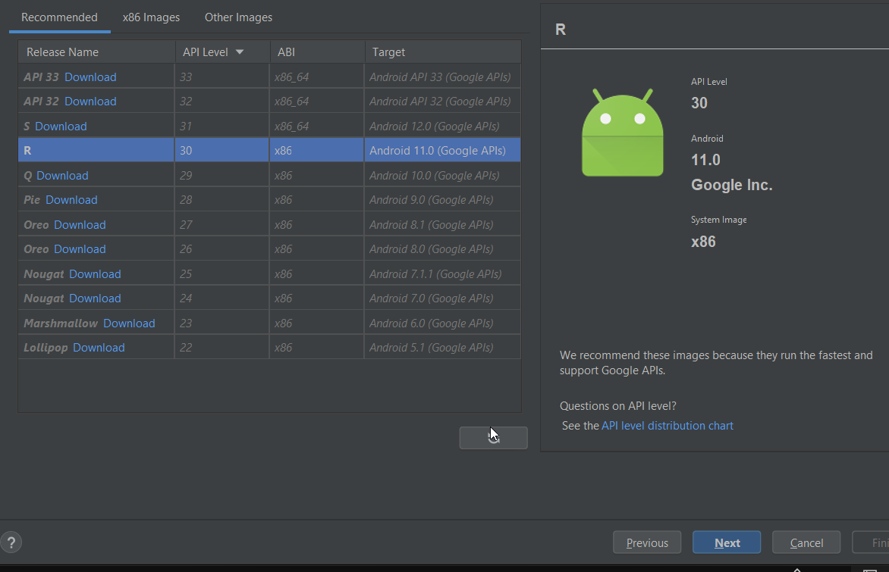
AVD for mobile
Content
Min 8 GB, upgrade RAM to 32 GB so that simulator work faster. It will slowdown computer.
www.anubhavtrainings.com

Slide 14
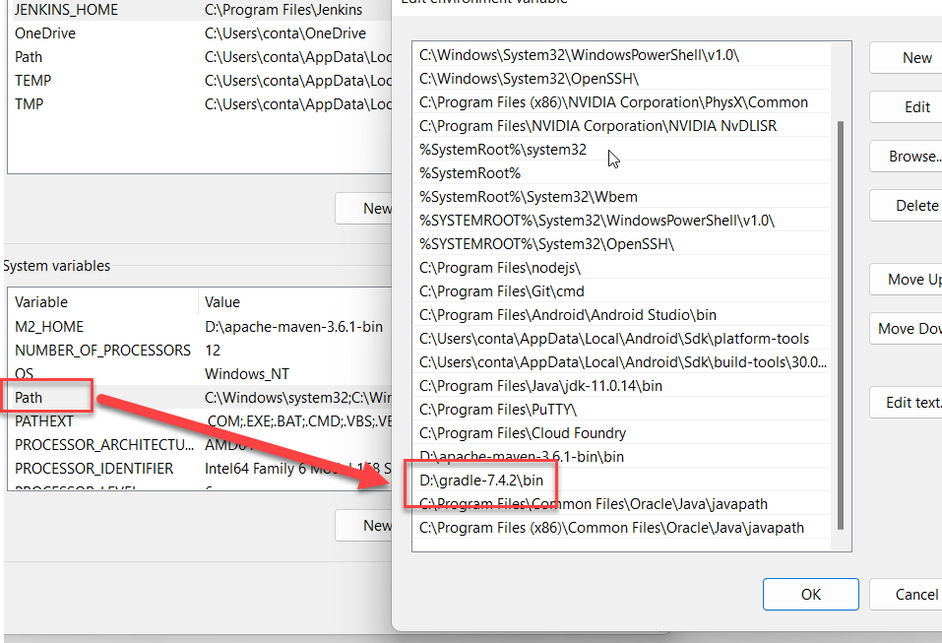
VS Code Development Tool
Main development tool for building SAP UI5 and Fiori Apps, then convert them to SAP Hybrid mobile applications.
https://code.visualstudio.com/
Now we need to add a projects folder in our computer and drag drop that to VS Code. Our workspace for building all our applications.
Source code management tool – backup and versioning of app
https://git-scm.com/download/win
To build an APK we need a build and packing tool called gradle
https://gradle.org/install/
www.anubhavtrainings.com

Slide 15
How to use your own android device
Install a tool called Vysor in your computer – It will project your mobile screen on your computer.
https://www.vysor.io/
You must have to use data cable which is capable to transfer data from phone to computer.
Enable developer mode.
www.anubhavtrainings.com

Slide 16
Cordova Basics
Cordova is a platform for building hybrid mobile applications using HTML, CSS and JavaScript.
The official documentation gives us the definition of the Cordova −
"Apache Cordova is an open-source mobile development framework. It allows you to use standard web technologies such as HTML5, CSS3, and JavaScript for cross-platform development, avoiding each mobile platform native development language. Applications execute within wrappers targeted to each platform, and rely on standards-compliant API bindings to access each device's sensors, data, and network status.“
Cordova Features
Command Line Interface (Cordova CLI)
This tool can be used for starting projects, building processes for different platforms, installing plugins and lot of other useful things that make the development process easier. You will learn how to use the Command Line Interface in the subsequent chapters.
Cordova Core Components
Cordova offers a set of core components that every mobile application needs. These components will be used for creating base of the app so we can spend more time to implement our own logic.
Cordova Plugins
Cordova offers API that will be used for implementing native mobile functions to our JavaScript app.
License
Cordova is licensed under the Apache License, Version 2.0. Apache and the Apache feather logos are trademarks of The Apache Software Foundation.
www.anubhavtrainings.com

Slide 17
Cordova Advantages
Cordova offers one platform for building hybrid mobile apps so we can develop one app that will be used on different mobile platforms – IOS, Android, Windows Phone, Amazon-fireos, blackberry, Firefox OS, Ubuntu and tizien.
It is faster to develop hybrid app then native app so Cordova can save on the development time.
Since we are using JavaScript when working with Cordova, we don't need to learn platform specific programming languages.
There are many community add-ons that can be used with Cordova, these have several libraries and frameworks, which are optimized for working with it.
www.anubhavtrainings.com

Slide 18
Cordova Limitations
Following are the limitations of Cordova.
Hybrid apps are slower than native ones, so it is not optimal to use Cordova for large apps that require lots of data and functionality.
Cross browser compatibility can create lots of issues. Most of the time we are building apps for different platforms so the testing and optimizing can be time consuming since we need to cover large number of devices and operating systems.
Some plugins have compatibility issues with different devices and platforms. There are also some native APIs that are not yet supported by Cordova.
www.anubhavtrainings.com

Slide 19
The Config.xml file
S.No | Element & Details
1 | widget The app reverse domain value that we specified when creating the app.
2 | name The name of the app that we specified when creating the app.
3 | description Description for the app.
4 | author Author of the app.
5 | content The app's starting page. It is placed inside the www directory.
6 | plugin The plugins that are currently installed.
7 | access Used to control access to external domains. The default origin value is set to * which means that access is allowed to any domain. This value will not allow some specific URLs to be opened to protect information.
8 | allow-intent Allows specific URLs to ask the app to open. For example, <allow-intent href = "tel:*" /> will allow tel: links to open the dialer.
9 | platform The platforms for building the app.
www.anubhavtrainings.com

Slide 20
Learn to create first cordova app
Create directory in our computer where we keep all our projects
Inside this directory we will enter command cordova create [folder] [namespace] [appName]
We need to add support for OS – cordova platform add android
The above command will check android sdk’s latest version and add that to our project. If you want to make your project with specific android version cordova platform add android@10.0.1
We can also check which version of android it is bulit cordova platform ls
Build our app which will create an APK file – cordova build
To test, connect phone with vysor and run command cordova run
www.anubhavtrainings.com

Slide 21
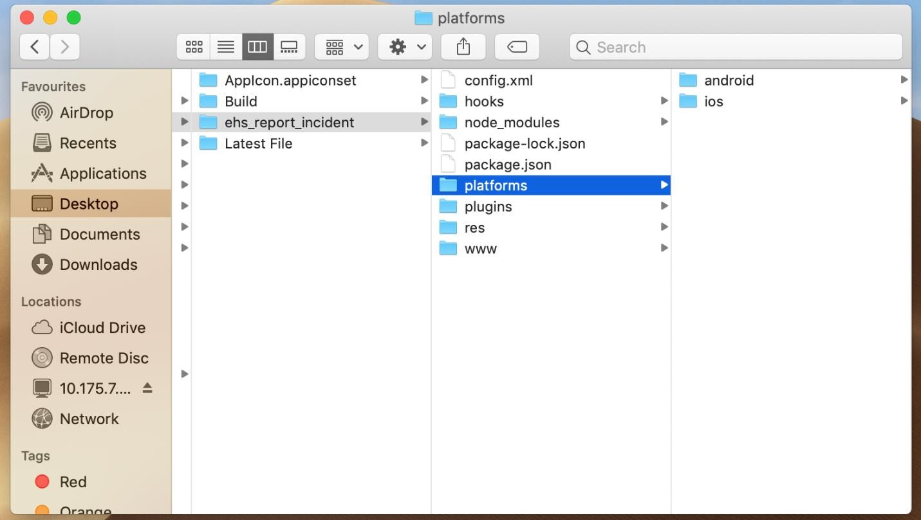
Add iOS platform to Cordova
STEP 1: Add iOS platform to the Cordova app
Open the Cordova application in terminal.
Add iOS Platform
Use the below command to add iOS platform.
cordova platform add ios
3. Once the platform added, it will be visible in your application directory.
www.anubhavtrainings.com

Slide 22
Setup for Mac OS
To build a hybrid application in iOS, you must have the below prerequisites
Prerequisites
Mac Device
XCode
XCode Simulator
To download XCode, go to the below link and download the suitable version. https://xcodereleases.com/
Now, to download XCode Simulator, you should follow the below steps
In XCode -> Preferences -> Download menu iOS 8.0 Simulator is not present. Some claim that this will not be available with EL Capitan, but I want to test my app against 8.0.
Install Node.js
Go to the below link to download the node.js https://nodejs.org/en/download/
To check if node.js was correctly installed, there should be a direct access the terminal
The Node version can be checked by node -v
www.anubhavtrainings.com

Slide 23
Cordova and Node installation
Install Cordova in Node.js
Proceed with the installation of Cordova executing the following command in the Node.js Command Prompt:
npm install -g cordova
As cordova will be globally installed, you can execute the command from wherever you are in the console. Once the installation has been completed, verify the version of cordova executing:
cordova –v
www.anubhavtrainings.com

Slide 24
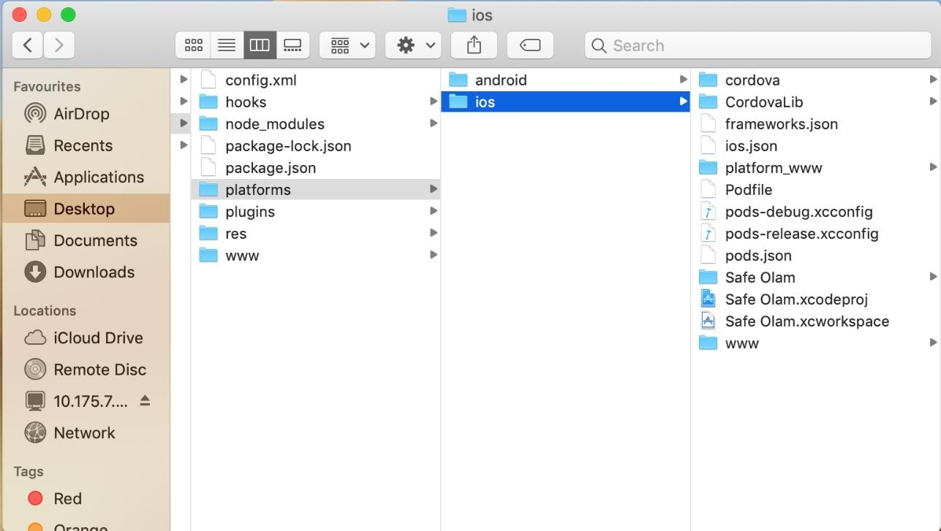
Build Cordova App - iOS
4. Double click on the ios folder.
5. Once you added the iOS platform, automatically XCode file will be generated inside the iOS folder. Click on the .xcworkspace file. The project will open in
XCode workspace.
www.anubhavtrainings.com

Slide 25
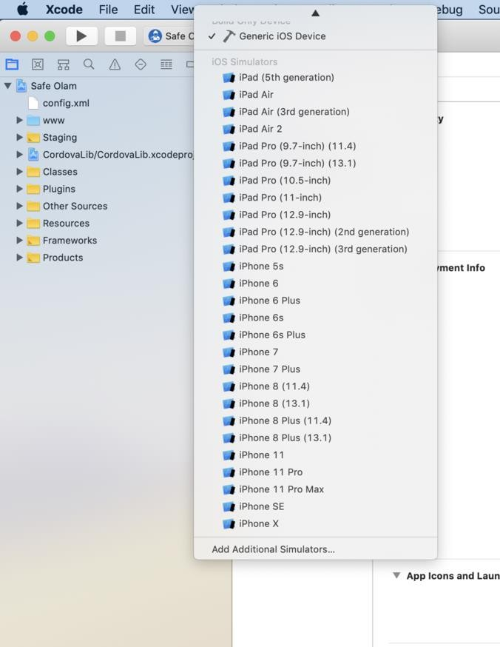

Build Cordova App - iOS
You can find your entire www content on the left pane. You can see the www content is also visible inside Staging folder. So, in case you are going to change some code, you need to change in both www content.
STEP 2: Build the cordova app in iOS
On the top, you will find the Build Option. You can test the app by selecting any iOS device from the simulator.
Once the app build successfully, it will launch Simulator.
www.anubhavtrainings.com

Slide 26
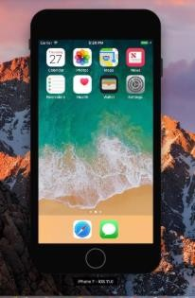
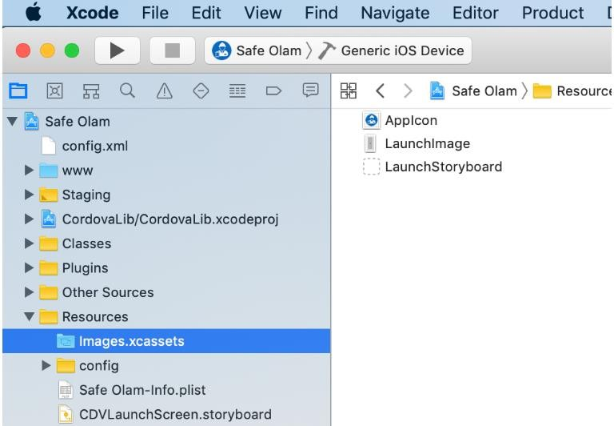
Build Cordova App - iOS
STEP 4: App Icon for the Application
You can upload app icons for the app. You need expand Resources, there will be Images.xcassets click on that, on the right side you can find the app icon.
STEP 4: App Icon for the Application
You can upload app icons for the app. You need expand Resources, there will be Images.xcassets click on that, on the right side you can find the app icon.
www.anubhavtrainings.com

Slide 27
Git and Git HUB
Distributed source code management tool and git HUB is a repository on internet which stores the code.
directory
Git hub
Local git repository
Email Anubhav – Anubhav.abap@gmail.com
Tell Anubhav the repo link - https://github.com/soyuztechnologies/hybrid_app_course01.git
Share your git user name so I can grant permission to you to view my code.
https://www.youtube.com/watch?v=MeNMYbR0W4g
www.anubhavtrainings.com

Slide 28

Yeoman Generator
Yeoman template
Productivity tool.
Standardization
Decrease time to create skeleton of our project
Faster adoption
Helps developer to speed up their development according to own company standards
Fiori App
webapp, manifest, ui5.yaml, package.json, component.js
routing, view, controller, i18n, formatters, models, utils, fragment
Fiori App
webapp, manifest, ui5.yaml, package.json, component.js
routing, view, controller, i18n, formatters, models, utils, fragment
Fiori App
webapp, manifest, ui5.yaml, package.json, component.js
routing, view, controller, i18n, formatters, models, utils, fragment
Fiori App
webapp, manifest, ui5.yaml, package.json, component.js
routing, view, controller, i18n, formatters, models, utils, fragment
Fiori App
webapp, manifest, ui5.yaml, package.json, component.js
routing, view, controller, i18n, formatters, models, utils, fragment
Fiori App
webapp, manifest, ui5.yaml, package.json, component.js
routing, view, controller, i18n, formatters, models, utils, fragment
Fiori App
webapp, manifest, ui5.yaml, package.json, component.js
routing, view, controller, i18n, formatters, models, utils, fragment
anubhav-basicfiori
Fiori App
webapp, manifest, ui5.yaml, package.json, component.js
routing, view, controller, i18n, formatters, models, utils, fragment
Fiori App
webapp, manifest, ui5.yaml, package.json, component.js
routing, view, controller, i18n, formatters, models, utils, fragment
Fiori App
webapp, manifest, ui5.yaml, package.json, component.js
routing, view, controller, i18n, formatters, models, utils, fragment
www.anubhavtrainings.com

Slide 29
Steps
Command Pallet and choose explore generator and find Anubhav-basicfiori
Install the generated and again F1, Run generator
Choose generator to create a new Fiori app myfioriappbase
Make following changes to generated app
Remove the dependencies from package.json file
Remove the routing for trump target
Change theme to sap_fiori_3_dark
Also add sap.ui.layout
Test our app using ui5 serve inside the folder. Fiori app is ready to be tested in our local browser.
Just copy all the webapp directory content and paste inside the www folder of hybrid app. Delete the index.html from www folder before you paste.
M
A
General Fiori app
chrome://inspect/#devices
www.anubhavtrainings.com

Slide 30
Bootstrap challenge
When we build Fiori app, we have the bootstrap code to download ui5 framework from sap website. This will cause 2 challenges
If the user is offline, the bootstrap wont download and eventually our app wont work
Lets say sap made some critical changes to their latest ui5 version which breaks somethings, app will stop working.
App becomes slow to start because it has to first download the ui5 libraries from internet.
framework
SAP Fiori
npm
www.anubhavtrainings.com

Slide 31
Steps – Locally getting ui5 resources
Open terminal and navigate to base ui5 application
Add the sapui5/open ui5 to our project dependency – ui5 use openui5
Add the dependent libraries which needs to be downloaded from npm website – ui5 add sap.ui.core sap.m sap.ui.layout themelib_sap_fiori_3
We can cross check the ui5.yaml
Go ahead and build our project – ui5 build self-contained –all
Download all these dependencies from node and create a dist/resource folder in our local machine which has all the dependencies required to run our project
We need to change our bootstrap to connect to local resources for ui5 – index.html and change the resource path to local
Created a ui5-dist.yaml by copy from ui5.yaml and then we add below content
resources:
configuration:
paths:
webapp: dist
9. Finally we test our app with dist folder - ui5 serve --config ui5-dist.yaml
Documentation - https://sap.github.io/ui5-tooling/
www.anubhavtrainings.com

Slide 32























Aspects of improving performance
The application code - we have controller, views, manifest, fragments, js, dependencies,….
UI5 resources – libraries, themes etc.
view
controller
i18n
js
fragments
www.anubhavtrainings.com

Slide 33
Steps to improve performance
Application → https://sap.github.io/ui5-tooling/pages/Builder/
We will use the standard task generateComponentPreload
Command we used to build was ui5 build self-contained --all --include-task=generateComponentPreload
We can observe that Component-preload.js was generated which has all the resources, we can delete manually all the folders for our app now except model, style, manifest.json, index.html
Run the app to check what it loads, application loading time will increase by 90%
Similarly we also want single file or a few files for ui5 resources - ui5 build self-contained --all --include-task=generateComponentPreload generateLibraryPreload
It will create sap-ui-custom.js file which contains most of sap ui5 library code
Additionally we can delete dist folder before rebuild - ui5 build self-contained --clean-dest --all --include-task=generateComponentPreload generateLibraryPreload
We can notice that in resource folder we have got sap-ui-custom.js which is a self contained of entire ui resource.
We can test our app and check network tab to find, just the bare minimum required to run our app
Change index.html bootstrap to this new sap-ui-custom.js
We found below files
www.anubhavtrainings.com

Slide 34
Resource
Application
Index.html
Component-preload.js
Model
style
UI5 libraries
resources/sap-ui-custom.js
sap/ui/core/date/Georgian.js
Messagebundles from m, core, layout
Theme resoruces
www.anubhavtrainings.com

Slide 35
Why Custom Fiori Login Screen?
When we develop a Fiori app for the organization, usually we deploy the same on
S/4HANA op system - SAP Fiori Launchpad – SAP Users SU01
SAP BTP CF environment - SAP Fiori cFLP - XSUAA
The authentication and authorization is provided by the infrastructure
When we develop a mobile app, the application is running independently. In order to make sure that our user is valid and authenticated, we have 2 approaches
Manual authentication – user, password click on Login
IdP – Identity Provider – LDAP Directory, Gsuite, Linkedin, Facebook
www.anubhavtrainings.com

Slide 36
Challenge design in Navigation
App
SplitApp
Design a new view Login View – App-VBOX,Form Container, Form Elements, Label, Input, Button, Icon
Change Routing configuration
Root view to our login
SplitApp View – subroute [master, detail]
On login click, trigger the subroute
www.anubhavtrainings.com

Slide 37


















Integration of OData with Hybrid Apps
Past
Hybrid App
www.anubhavtrainings.com

Slide 38
Steps
Integrate with OData Model, we will create the model dynamically in login screen
Take the credentials and pass that to the odata model
Attach an Odata Event called attachMetadataLoaded , if the metadata is loaded, it is a confirmation that the credentials passed by user worked with SAP system. We will let the login happen.
Binding needs to be done in our app, existing local model needs to changed to named model
Scenario 1 – Testing in local machine as a webapp in browser – maintain proxy settings in UI5 yaml file and test
Scenario 2 – deliver hybrid app – add the hostname along with service details to the model
Add a special configuration in config.xml file of hybrid app to allow chrome to send traffic to external server from device
For Training server access email – server@anubhavtrainings.com
www.anubhavtrainings.com

Slide 39
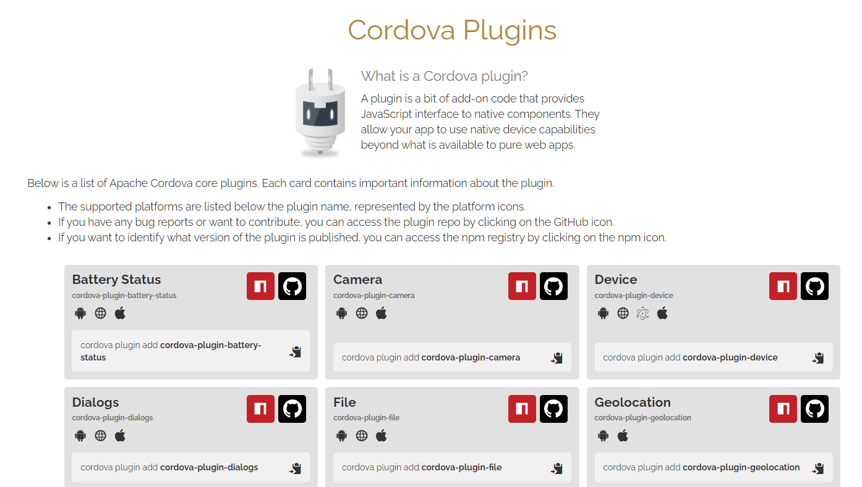
What is Cordova Plug-ins
A plugin is a bit of add-on code that provides JavaScript interface to native components. They allow your app to use native device capabilities beyond what is available to pure web apps.
www.anubhavtrainings.com

Slide 40
Splash screen
Content
Splash screen
App start
www.anubhavtrainings.com

Slide 41






















Camera Integration
www.anubhavtrainings.com

Slide 42
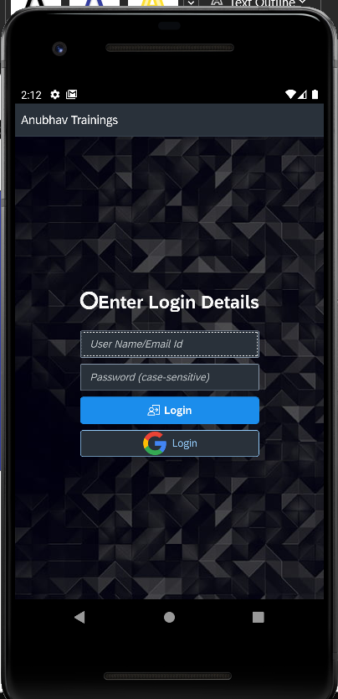
Offline Database
At least user has earlier logged in successfully with online mode. We will store these credentials in offline DB. Store password as base64 stream.
S/4HANA Server
To load metadata
If metadata loaded
yes
navigate
no
If first time
If the credentials are stored inside offline db
no
Correct?
yes
sqlitedb
Store the password
yes
no
Error
www.anubhavtrainings.com

Slide 43
Basics of SQLite DB
It is a light weight file-system based database
It is an open-source
Suitable for small size of data
Allows preforming SQL operations
Also works with cordova in mobile phone
Learn how to create a simple sqlite database
Test Create table command to build a small table for sample data
Insert data with query
Select data from table using query
www.anubhavtrainings.com

Slide 44
Integrate with mobile app
Install the cordova-sqlite-storange plugin to the hybrid app – cordova plugin add cordova-sqlite-storage
Download the cordova.js from study material and include in main folder, when we build, the same file should be copied to the www folder. Add the same to the script task
Move the script to the bootstrap header part
Change the initialization code inside index.html file where we check if we run app in mobile or in browser
If we run in browser, directly log the app
Else we initialize an offline store using sqlite plugin, also create our user login table if does not exist --Functional flow
Once the user login, if user is online, the credentials are successful with odata, we will store these credentials in the offline store in our user table (password will be stored in encrypted format)
Next time, we login, if we are online, we will let user login and overwrite offline values if the values of same user id is there, for a different user id we will insert
If device is offline, check the credentials with offline store, on success, we will navigate
On fail we will error
Note: Make sure that all the subsequent DB calls will not work like traditional programming languages. Hence we need to make use of promise concept.
www.anubhavtrainings.com

Slide 45
Title
Index.html
Component.js
offline.js
Index.html
sqliteDB;
Offline.js module
Are we in mobile?
Initialize offline store and create tables
Component.js
www.anubhavtrainings.com

Slide 46
Promise Concept
https://www.youtube.com/watch?v=zY6gnfxgb9I&t=180s
www.anubhavtrainings.com

Slide 47
Challenge and Solution
Current approach is targeting single table
With these single table, we also have exact columns and conditions
This approach is not reusable and not scalable
In future, if we need more tables, we need to write lots of duplicate code for INSERT, UPDATE, SELECT, DELETE, UPSERT (Update + Insert), READCOUNT, READLIMITROWS, READBYKEY…
Solution
We need to develop our code in such a way that we not hardcode our table names, and conditions. We will have more generic API to communicate to the offline DB.
We no need to write so much lines of code every time we need new table
Code is clean and reusable
Easy to consume by everyone
If we fix one place, for everyone its fixed
We want to control any security on data, it can be done centrally
Enhanced for future development
Bring down the effort and time for development
Note: The API is developed to be integrated with UI5 client-side JS code. If you want to use it in nodejs, we need to do some tweak.
This can be used both synchronously and asynchronously.
www.anubhavtrainings.com

Slide 48
Implementation of Read(GET) offline
User must start our app for the first time in the online mode
At this time, we will fill our offline db with a time stamp
Design an offline table which keeps all the data (tricky), it depends on our use case
We can store each record by record data
We can store entire JSON
Fiori App
Local JSON Model
no
offline
yes
OData
SAP S/4HANA system
SQLite offline DB
www.anubhavtrainings.com

Slide 49
Structure of offline table
Column | Type
Operation | GET, POST, PUT, DELETE
EntitySet | …
Data (json)
Timestamp
SyncTimestamp
DeleteFlag (Boolean)
www.anubhavtrainings.com

Slide 50
Title
Fiori App
Content
Sync Changes
(new Screen)
write
Offline SqliteDB
online
online
yes
yes
SAP s/4HANA Server
www.anubhavtrainings.com

Slide 51
Open Question
Can we use the mock server concept with offline store?
What are the best practices, considerations when client is willing to implement offline apps?
Can we store images in gallery of mobile phone, because I tried many plugin but none of the worked?
www.anubhavtrainings.com

Slide 52












Can we use the mock server concept with offline store?
Mock server in SAP UI5 is a module provided by SAP to mock data. Purpose is that in case our SAP S/4HANA server is down, and since our Fiori app depends on the data of the server, we will be sitting idle.
www.anubhavtrainings.com

Slide 53
What are the best practices, considerations when client is willing to implement offline apps?
Effort wise it will 3-4x more effort for offline implementation. E.g. if an online app takes 6 h to build, the same app with offline store will take 18-24 h.
The design of offline DB tables depends on requirement to requirement. If we want fine granular control on each record, we need to replicate back end design to SQLite DB as it is with timestamp to sync our changes. OR you can take approach of storing entire json.
Once you design SQLite DB tables, later the app is in the production, we cannot change DB design of SQLite DB as easy as during development because customer is already using offline store.
You need to see how much data you want to load when app starts, you can load entire app data in offline store at the beginning or only the data of screen where user navigate.
Synchronizing offline data to online store should also be considered and thought off properly to avoid data clash. We should ideally consider the timestamp to compare when was the last update was done.
When we are updating data from offline store to online store, massive number of records goes to back end. We need to see what is the best possible way as per the requirement.
During the sync process of multiple records, we need to also take care of error handling and let user know which records did not sync or sync. One is we can create a offline store table of errors. OR a log table in server to track date, time, user, record data and issue.
www.anubhavtrainings.com

Slide 54
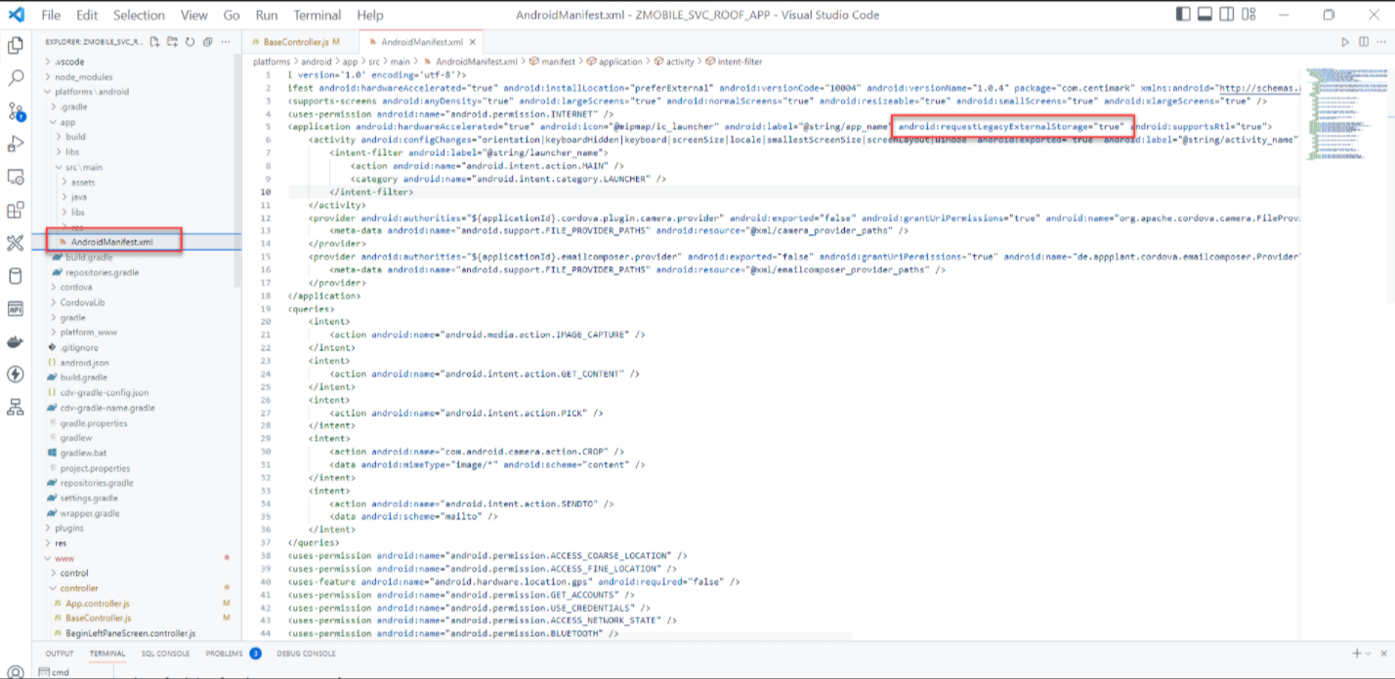
Title
Content
https://cordova.apache.org/docs/en/latest/reference/cordova-plugin-file/index.html
In my code you can refer these 2 functions to save a base64 image in gallery to a desired folder these are in the Base controller at the bottom
b64toBlob
savebase64AsImageFile
www.anubhavtrainings.com

Slide 55
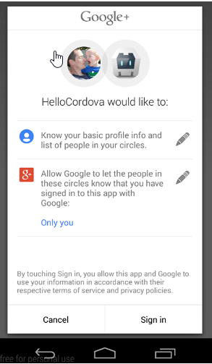
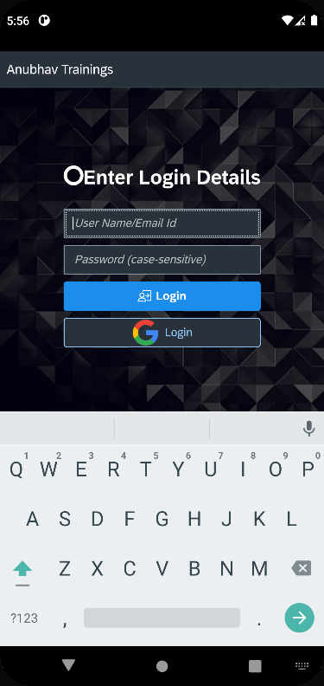
Google Authentication – user flow
2 Approaches
Create firebase app – 3rd party which provide authentication mechanism with multiple social media a/c
Directly create a project with google
Plugin provided by google to integrate with cordova android app
https://www.npmjs.com/package/cordova-plugin-googleplus
Email id
SAP S/4HANA
Table
EMAIL - USER
Callback
Where we can read the user information what was successfully logged in
Email, id, name, last name, …
www.anubhavtrainings.com

Slide 56
Developer Flow
Developer Console
Client APP
Client_id
Our app
Add plugin
Call plugin code
Google Engine
For Authentication
www.anubhavtrainings.com

Slide 57
Follow the process to create client id
Login to https://console.cloud.google.com/ using personal or corporate account
Create a new project with some name
Enable API and enable Google + API
Go to credentials, create Credentials and choose OauthClient Id
Choose consent screen as External type
Provide appname, support email, and company login and support email id
No Scope, Save and continue
Publish the app
Go to credentials, create Credentials and choose OauthClient Id
Choose app type Android
Provide name, package name from config.xml of our cordova app, generate the SHA certificate with below command
keytool -keystore "C:\Users\YOUROWNUSER\.android\debug.keystore" -list –v
Copy the SHA1 and paste in google console, it create a client id
We take client id and generate reverse client id
Now will install plugin to our cordova project with client id
cordova plugin add cordova-plugin-googleplus --save --variable REVERSED_CLIENT_ID=YOUROWNREVERSEID
- Next command cordova prepare
www.anubhavtrainings.com

Slide 58



We’re committed to empower you to be
Most Desirable Resource
through powerful training solutions.
We build the workforce of the future.
250+
Corporate Clients
30,000+
Learners Trained
25000+
Learners Placed
contact@anubhavtrainings.com
FREE WEBINARS
Sign up for free webinars with industry experts every fortnight!
Enroll Now!
Contact us today!
https://anubhavtrainings.com/

Slide 59

Scenario Introduction
Mike is working as a service foreman in one of the car manufacturing company.
A service Foreman will use this App and enter the count(remaining materials available at the Job Site). The Foreman will do this on a weekly basis.
The App should scan UPC barcode, based on the mapping, and get SAP material #. If there is no mapping, provide the option to Foreman to enter SAP material number manually. Then the foreman will enter the count of remaining materials, go to the next material and continue like this till they complete all materials.
Once complete, they will send the data to backend Z table where Warehouse manager will look at it and post it. I am guessing this App to be much simpler than our Service Mobile App.
www.anubhavtrainings.com

Slide 60
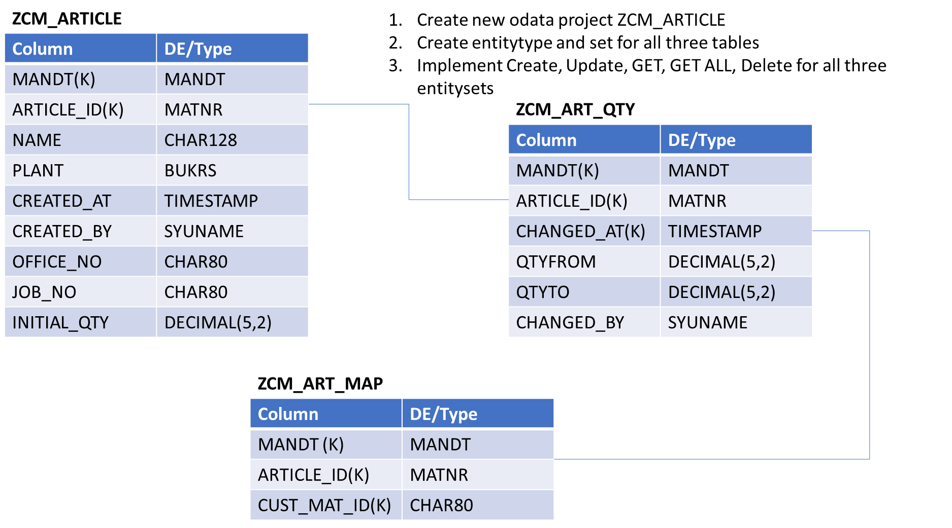
Database Design
www.anubhavtrainings.com

Slide 61
Session – Scenario For End to End App
Fiori App Development for the Scenario
Testing Fiori App locally
www.anubhavtrainings.com

Slide 62
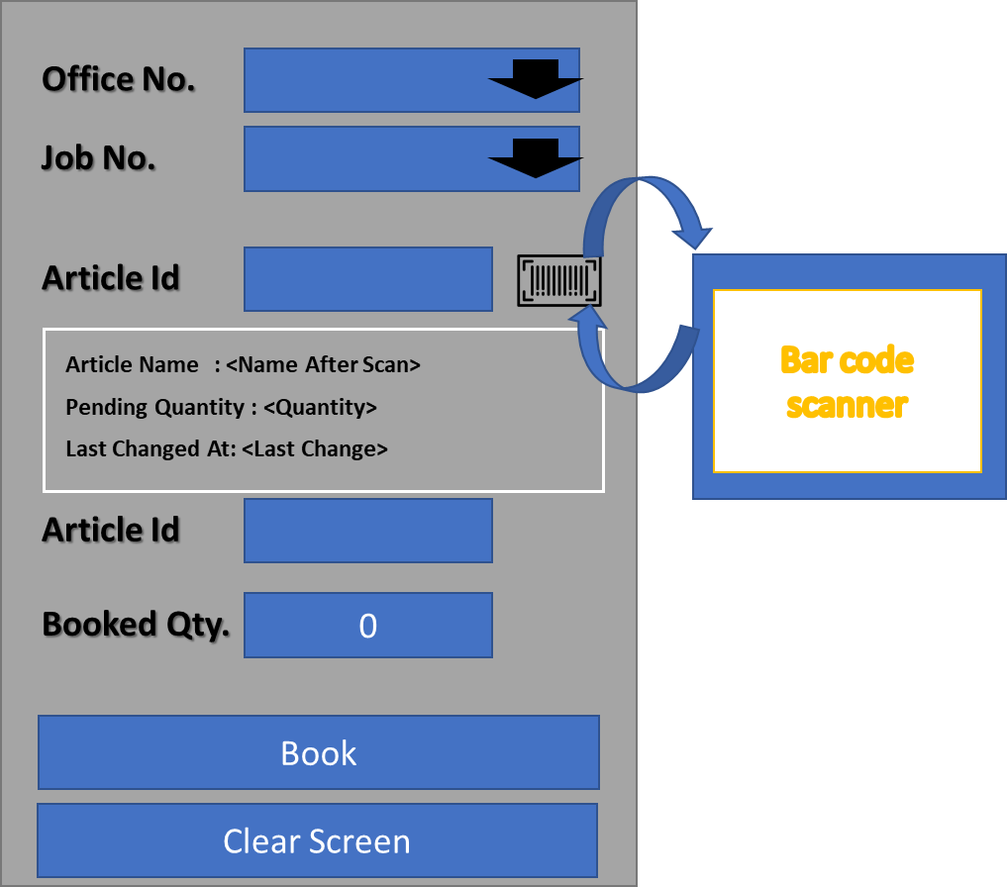
Fiori App – UI Mockup
www.anubhavtrainings.com

Slide 63
Steps to Create Release APK
Generate Key Signing Certificate
keytool -genkey -v -keystore app-key.keystore -alias app-key -keyalg RSA -keysize 2048 -validity 10000
Create build.json in root folder
{
"android": {
"release": {
"keystore": "app-key.keystore",
"storePassword": "welcome",
"alias": "app-key",
"password": "welcome",
"keystoreType": ""
}
}
}
Perform the cordova build
cordova build android --release -- --packageType=apk
www.anubhavtrainings.com

Slide 64
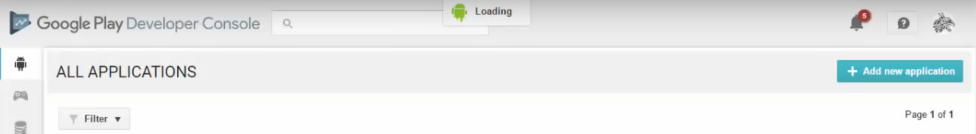
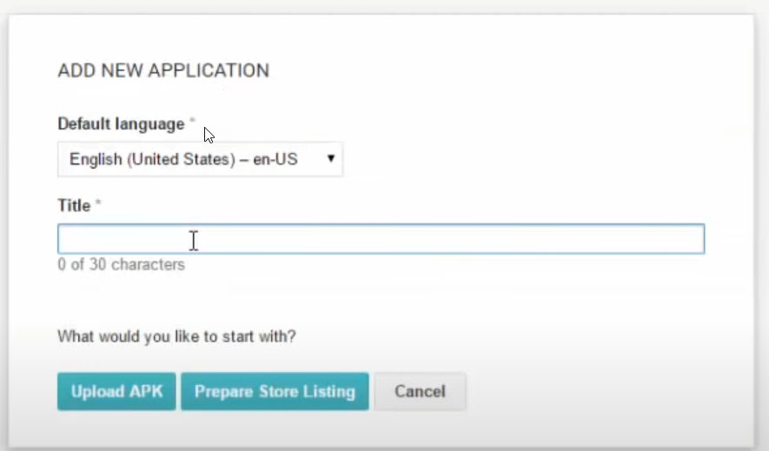
Upload APK to Android Store
www.anubhavtrainings.com

Slide 65
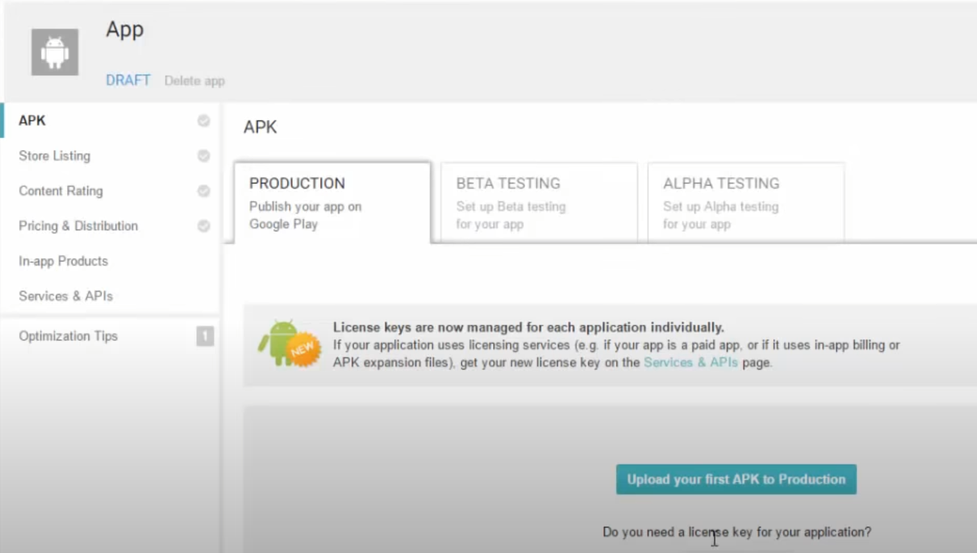
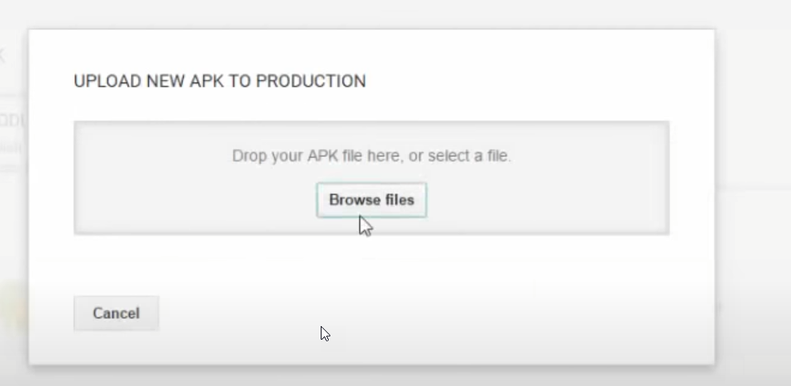
Upload APK to Android Store
Content
www.anubhavtrainings.com

Slide 66
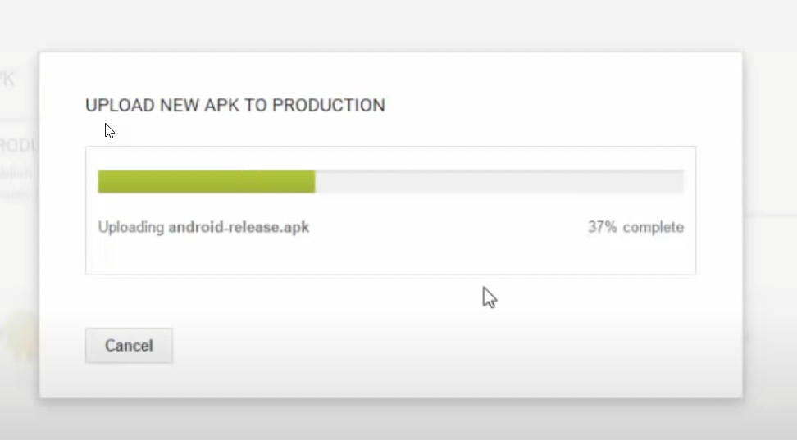
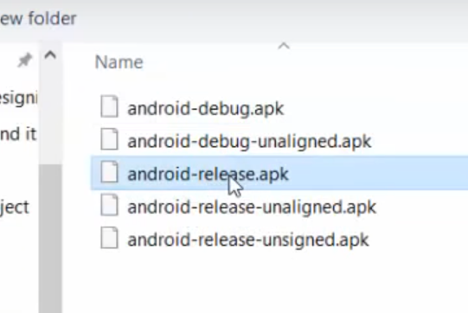
Upload APK to Android Store
Content
www.anubhavtrainings.com

Slide 67
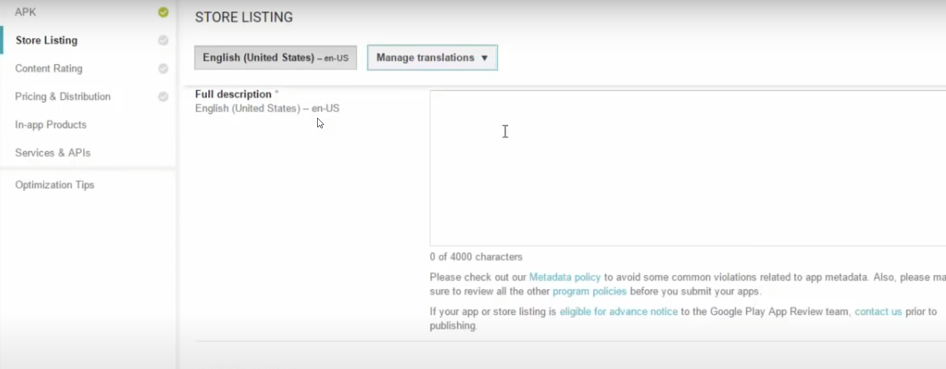
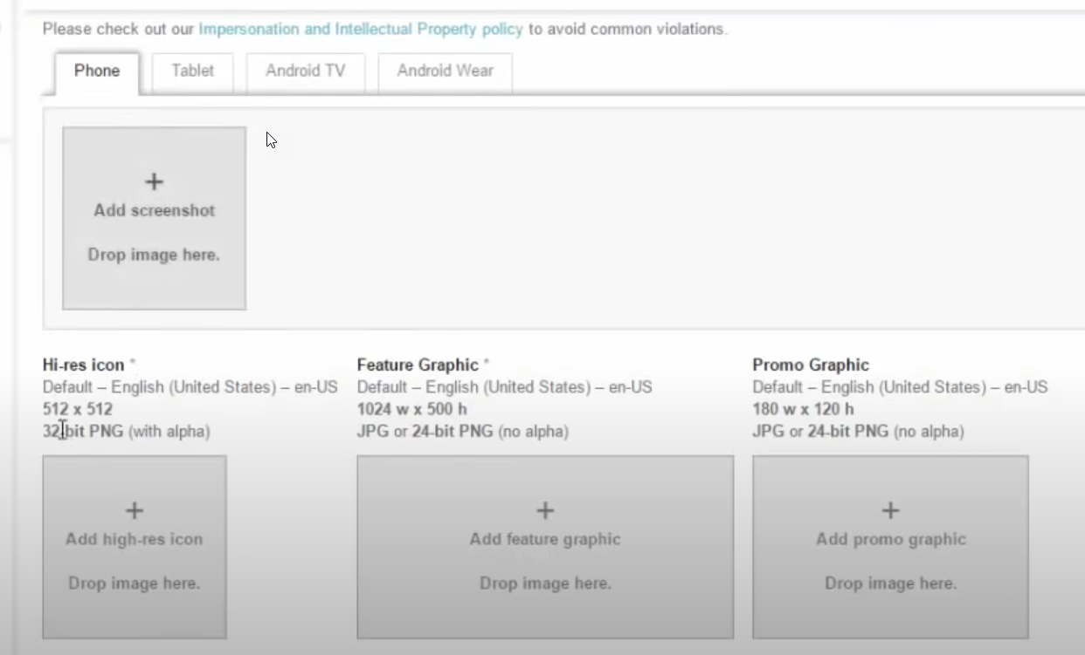
Upload APK to Android Store
Content
www.anubhavtrainings.com

Slide 68
What is MDK – Mobile Development Kit
The SAP Mobile Development Kit (MDK) enables developers to build multi-channel applications. It allows us to build our application once, in an integrated development environment (mobile mdk cockpit + BAS), and run it natively on mobile devices and as online web application.
Top use cases
Build Multi-channel application – it generates the metadata and java script code in the editor which is translated to native device code automatically at runtime. The same metadata can also be deployed to the web to run same app in the browser.
Deploy updates easily – Our app can be updated in just few clicks. We don’t need to worry about the signing process. SAP provide an SAP MDK Client application which end user needs to download and use to run the app. The update will be done automatically by the MDK Client.
Customize and extend the app with reuse component – Reusable components are stand-alone apps that can include pages, actions, rules and global variables. As a stand alone components they can be built, tested, updated without touching primary application.
https://cockpit.hanatrial.ondemand.com/trial/#/home/trial
www.anubhavtrainings.com

Slide 69
Title
SAP BAS
SAP mobile service cockpit
Dev space
SAP BTP
SAP Mobile Service
App
App
App
Device
App
BTP Destination Service
SAP xsuaa service
destination
SAP MDK Client
SAP S/4HANA
www.anubhavtrainings.com

Slide 70
Purpose of destination
A destination is a connection to our Service from where our app will take data from. Like in classic SAP system we have R3 connections of type RFC.
Mobile
Server
ESPM Service
Mobile service cockpit destination
Web Application
SAP BTP Destination
The destination that we will create is first going to connect to mobile service destination and through that it will connect to our server. So this destination type will be OAuth2JWTBearer type destination.
www.anubhavtrainings.com

Slide 71
Understanding the application structure
Application.app this is the main configuration file for our app from within BAS. Here we define the starting events and pages which will be booted at the start of the application. Also we can set different stages of the app session lifecycle, push notification and more.
Main.page This is the first screen of our MDK app. Actual functionality starts from this page. SAP provide a graphical editor to change and add new UI elements to this page.
InitializeOffline.action For mobile applications, this action will bind the app to offline OData Server and downloads the required data in the offline store inside our device. If we want application to download the updated data from online service to offline store we can use this action again.
OnWillUpdate.js this rule is applicable to mobile client only. MDK application will automatically download the updates and apply the changes to the client without end user taking any action. The onWillUpdate will empower our end users to run business logic before the new application updates are applied in mobile.
DownloadOffline & UploadOffline These are again application only for mobile application. Basically these actions are used to sync our data between the offline store and the actual odata service from server.
Web – this contains the additional resources for the web application which runs in browser. There is offline capability possible for the web application.
www.anubhavtrainings.com

Slide 72
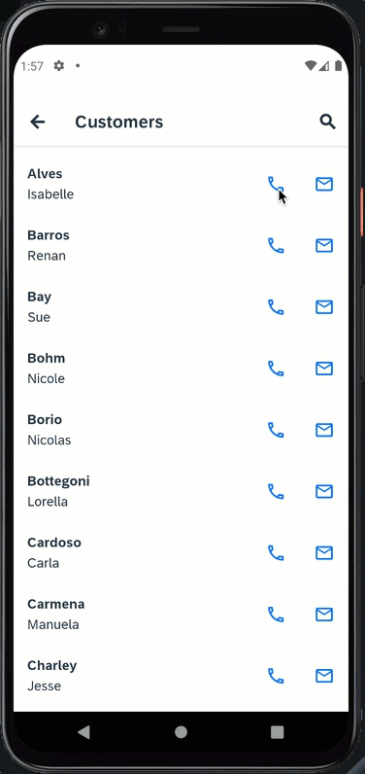
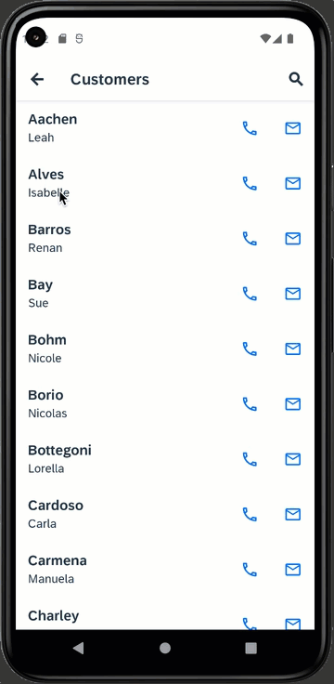
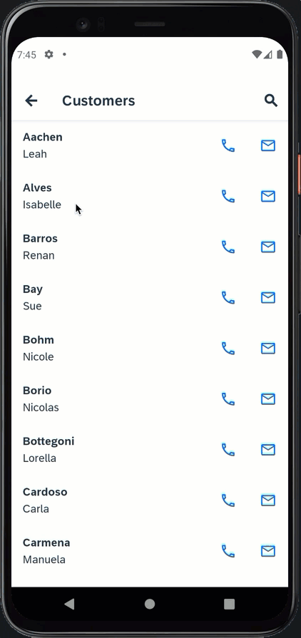
Customer list App
www.anubhavtrainings.com

Slide 73
Steps
Create a Form Cell Page
A form cell page is suitable for pages that generate New or modify existing object like customer, order, supplier etc. It includes a form container in which we can add form elements (label+field).
Add simple property
Validate
Cancel
Update
Success - close
Failed – Throw error
www.anubhavtrainings.com

Slide 74
MDK Documentation
https://help.sap.com/doc/f53c64b93e5140918d676b927a3cd65b/Cloud/en-US/docs-en/guides/features/fiori-ui/mdk/formcell-page.html
www.anubhavtrainings.com

Slide 75
Title
Content
www.anubhavtrainings.com

Slide 76
Title
Content
www.anubhavtrainings.com

Slide 77
Title
Content
www.anubhavtrainings.com

Slide 79
FAQs
1.What will be the duration of the training, pre-requisite?
The duration of the course is 25 Hours, and UI5 and Fiori development with OData is must.
2.The timing does not suite me so can I go for video mode?
The course is only available in the video mode.
3.What tool do I need to learn and where do I get?
You should know VS Code and Node JS, BAS will be added advantage.
4.Will you show OData connectivity?
Yes, we will do the OData connectivity
www.anubhavtrainings.com

Slide 80
FAQs
5.Will you cover bar code and offline integration?
Yes, we will be covering bar code integration in this course. We will also cover offline feature for app.
6. Do we create apk for android ?
Yes, we will be creating the android apk in this course.
7.Will you teach MDK in SAP BTP?
Yes, we will cover MDK development also in this course.
8.Process to enroll for this course?
Please mail us on contact@anubhavtrainings.com
For More Details !!
Please visit
www.anubhavtrainings.com/faqs
www.anubhavtrainings.com

Slide 81

www.anubhavtrainings.com
THANK YOU

